Slide 1
Lecture 5
Aliasing
(Pseudo Creation of Original)

Slide 2
Contents
5.1 Introduction
5.2 What Causes Aliasing?
5.3 Anti-aliasing
5.3.1 Prefiltering
5.3.2 postfiltering

Slide 3
5.1 Introduction
Aliasing is the appearance of jagged distortions in curves and diagonal lines in computer graphics because the resolution is limited or diminished.
In statistics, signal processing, computer graphics and related disciplines, aliasing refers to an effect that causes different continuous signals to become indistinguishable (or aliases of one another) when sampled (digitized).
It also refers to the distortion or artifact that results when a signal is sampled and reconstructed as an alias of the original signal.

Slide 4
Introduction-contn
Sampling is the key technique used to digitize analog information.
For example, music CDs are produced by sampling live sound at frequent intervals and then digitizing each sample.
The term sampling is also used to describe a similar process in digital photography
In digital imaging, a pixel (picture element x) is the smallest piece of information in an image.
Pixels are normally arranged in a regular 2-dimensional grid, and are often represented using dots, squares, or rectangles.
Each pixel is a sample of an original image, where more samples typically provide a more accurate representation of the original.

Slide 5

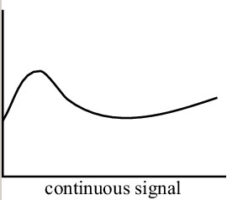
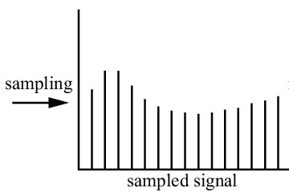
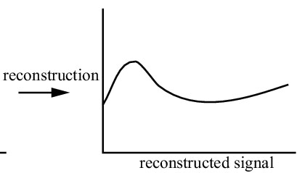
Introduction-contn

Slide 6
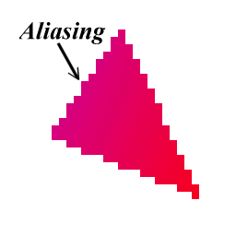
Introduction-contn
When we view a digital photograph, the reconstruction (interpolation) is performed by a display or printer device, and by our eyes and our brain.
If the reconstructed image differs from the original image, we are seeing an alias.
Visual artifacts includes:
Moiré patterns
Jagged ( toothed ) edges
Loss of detail
Flickering in animations
Techniques that avoid such poor pixelizations are called anti-aliasing.

Slide 7
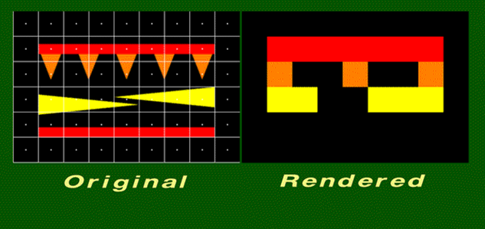
Loss of Details

Slide 8
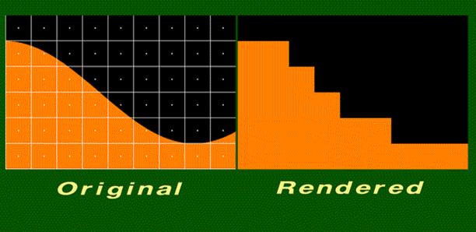
Jagged Edges

Slide 9
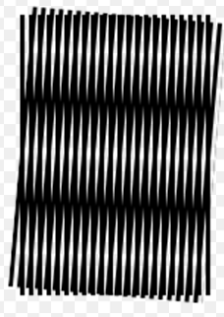
A moiré pattern, formed by two sets of parallel lines, one set inclined at an angle of 5° to the other ( lack of alignment at edges )
Moiré patterns

Slide 10
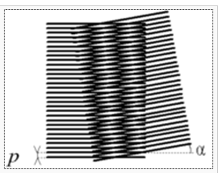
Moiré obtained by the superimposition of two similar patterns rotated by an angle α ( lack of alignment at center )
Moiré patterns -contn

Slide 11
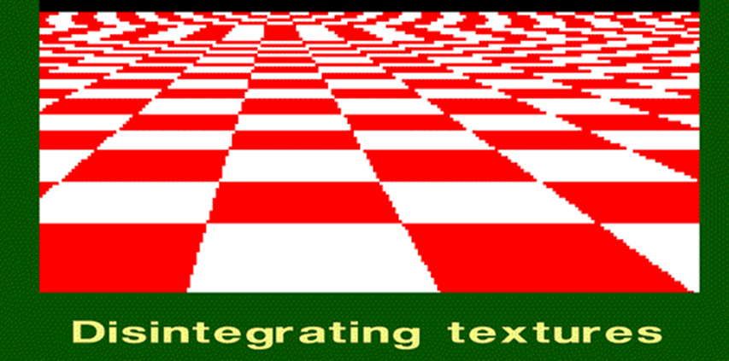
This is a checkered texture on a plane. The checkers should become smaller as the distance from the viewer increases.
However, the checkers become larger or irregularly shaped when their distance from the viewer becomes too great.
Simply increasing the resolution will not remove this artefact. Increasing the resolution will only move the artefact closer to the horizon.

Slide 12
Introduction-contn
Temporal aliasing is a major concern in the sampling of video and audio signals. Music, for instance, may contain high-frequency components that are inaudible to us.
If we sample it with a frequency that is too low and reconstruct the music with a digital to analog converter, we may hear the low-frequency aliases of the under sampled high frequencies.
Therefore, it is common practice to remove the high frequencies with a filter before the sampling is done.
Situations also exist, where the low frequencies are removed (if necessary); and the high frequency components are intentionally under sampled and reconstructed as lower ones.

Slide 13
Introduction-contn
Like the video camera, most sampling schemes are periodic; that is they have a characteristic sampling frequency in time or in space.
Digital cameras provides a certain number of samples (pixels) per degree or per radian, or samples per mm in the focal plane of the camera.
Audio signals are sampled (digitized) with an analog-to-digital converter, which produces a constant number of samples per second.
Some of the most dramatic and subtle examples of aliasing occur when the signal being sampled also has periodic content.

Slide 14
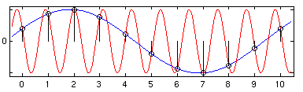
Introduction-contn
Two different sinusoids that fit the same set of samples.
The blue signal is most probable to have aliasing due to poor sampling

Slide 15
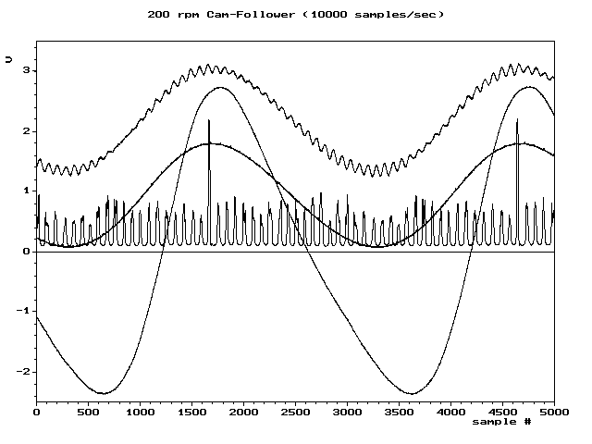
Introduction-contn
Aliasing animated gif - a graph of signals sampled at different rates (10000,2000,1000,500,200,100 samples /sec) showing how the character of some signals change dramatically when the rate is too low.

Slide 16
5.2 What Causes Aliasing?
Aliasing happens if we do not sample the (continuous) image densely enough.
So , we are not capturing the image details (high frequencies) with our discrete pixel grid.
Notice that , high frequencies arise at sharp edges, or during perspective projections of texture images.

Slide 17
Sampling Theorem
In order to accurately reconstruct a signal, the signal must be sampled at a rate greater than or equal to two times the highest frequency contained in the signal ; and this is called the Nyquist Theorem
The highest frequency that can be accurately represented with a given sampling rate is called the Nyquist limit.
The sampling frequency, f_{s} , must be at least twice the maximum frequency, f_{max} , of the function

Slide 18
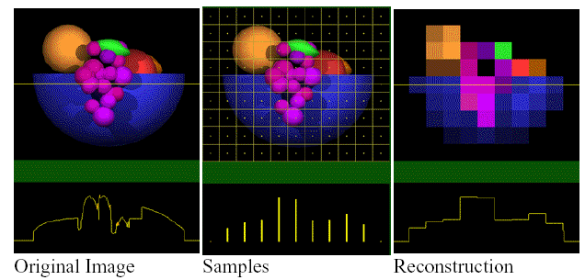
Bad Sampling Effect
If we reconstruct the signal badly, we get aliasing

Slide 19
5.3 Anti-aliasing
There are two ways of dealing with aliasing:
The first is to low pass filter our signal before we sample it ( prefiltering ).
The second is to increase the sampling frequency ( postfiltering or super-sampling).

Slide 20
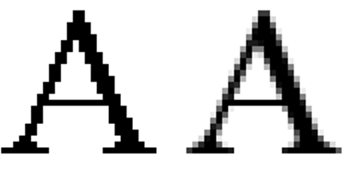
Antialiasing Example 1
Aliasing example of the A letter in Times New Roman.
Left: aliased image,
right: antialiased image.

Slide 21
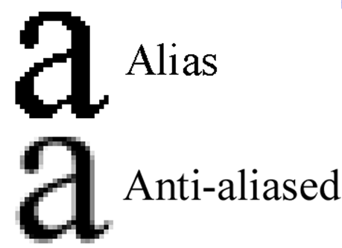
Antialiasing Example 2

Slide 22
How to use ant-aliasing filters
Anti-aliasing filters are commonly used at the input of digital signal processing systems, for example in sound digitization systems; similar filters are used as reconstruction filters at the output of such systems, for example in music players.
In the later case, the filter is to prevent aliasing in the conversion of samples back to a continuous signal, where again perfect stop-band rejection would be required to guarantee zero aliasing.

Slide 23
5.3.1 Prefiltering
This is a technique that determines pixel intensity based on the amount that a particular pixel is covered by an object in the scene. Determining such areas requires extensive calculations and integral approximations.
While the precision of prefiltering does generate more accurate antialiasing effects, its complexity and expensive calculations at times make it an undesirable method to minimize aliasing effects.

Slide 24
Prefiltering Example1
Prefiltering methods treat a pixel( before sampling ) as an area, and compute pixel color based on the overlap of the scene's objects with a pixel's area.
The original scene is a filled orange circle on a red background. All of the pixels inside the circle are 100 percent orange.
All the pixels on the boundary of the circle have some area that is red and some area that is orange.
The computed color for the highlighted pixel is 40 percent orange and 60 percent red.

Slide 25
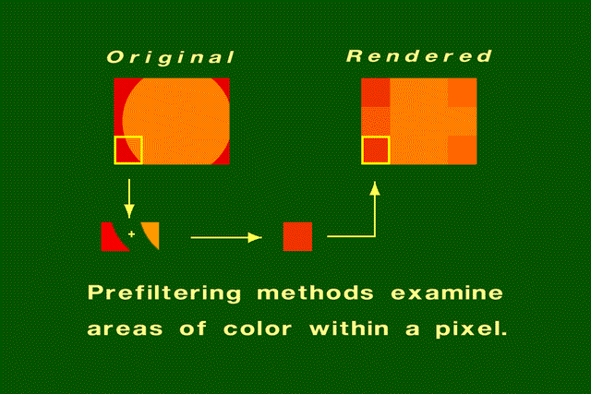
Prefiltering Example1 -contn

Slide 26
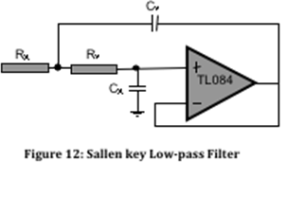
Prefiltering circuit diagram

Slide 27

Prefiltering Example2
Both phrases were rendered (a technique used to display a 2D projection of a 3D discretely sampled data set) at a resolution of 512x512.
Even at this resolution, the jaggies are apparent in the phrase that hasn't been anti-aliased.

Slide 28
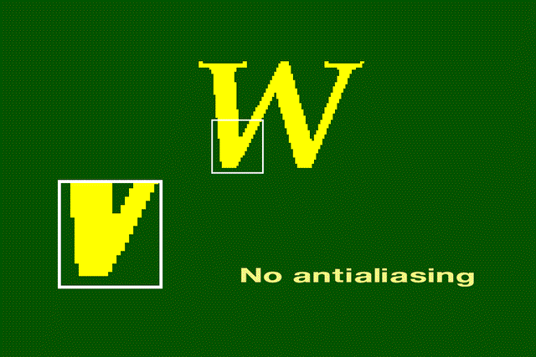
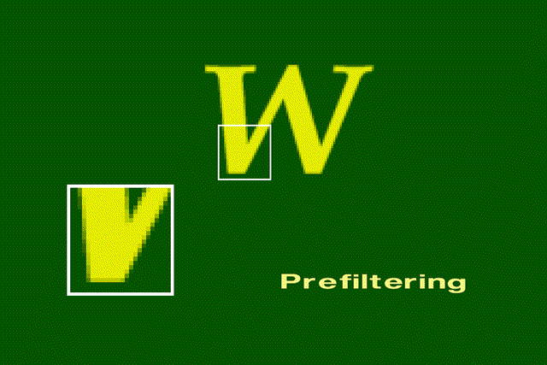
Close-up
Without anti-aliasing, the jaggies are harshly evident.
Along the character's border, the colors are a mixture of the foreground and background colors.
Using the anti-aliasing, enhance the sharpness of the image

Slide 29
Weighted Prefiltering
This is a subset of prefiltering that assigns different weights to the area calculations based on their position within the pixel.
For example, if an object intersects a pixel along the pixel edge and covers 20% of the pixel, the pixel may only receive 10% of the total intensity for the object.
If however, the same object intersected 10% of the pixel area but did so at the pixel's center, the pixel may receive 25% of the total intensity for the object.
The weighting assignment is based on particular weight distribution curves that often follow a bell-curve pattern.

Slide 30
5.3.2 Postfiltering
Postfiltering, also known as super-sampling, is the more popular approach to anti-aliasing.
For each displayed pixel, a postfiltering method takes several samples( after sampling) from the scene and computes an average of the samples to determine the pixel's color.

Slide 31
Postfiltering Example
The steps in the postfiltering process are:
Sample the scene at n times the display resolution.
For example, suppose the display resolution is 512x512, Sampling at three times the width and three times the height of the display resolution would yield 1536x1536 samples.
The color of each pixel in the rendered image will be an average of several samples. For example, if sampling were performed at three times the width and three times the height of the display resolution, then a pixel's color would be an average of nine samples. A filter provides the weights used to compute the average.

Slide 32
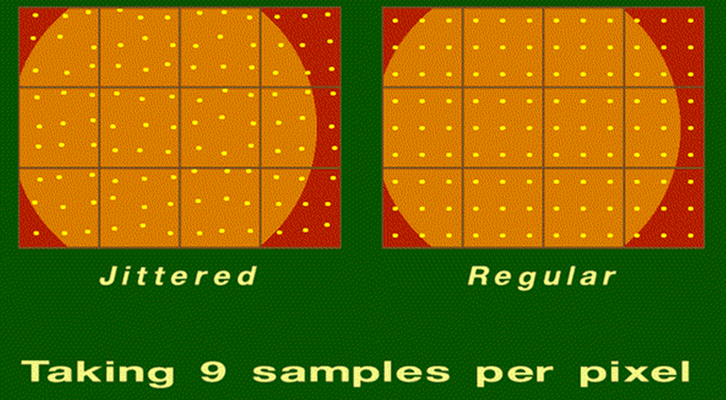
Sampling in the Postfiltering method

Slide 33
Sampling in the Postfiltering method-contn
In both figures, the display resolution is four pixels wide by three pixels high. The superimposed grid depicts the size of a pixel.
Both figures show supersampling at three times the height and three times the width of the display resolution.
In the right figure, the samples are regularly spaced.
In the left figure, the positions of samples are displaced by a random amount. The random amount is small relative to the size of the pixel.
This method of perturbing the sample positions is known as "jittering." Jittering adds noise to the rendered image.

Slide 34
Super Sampling & Rendering
In which, Samples are taken at several instances inside the pixel (not just at the center as default) and an average color value is calculated.
This is achieved by rendering the image at a much higher resolution than the one being displayed, then down sampling (shrinking) it to the desired size, using the extra pixels for calculation.
The result is smoother transitions from one line of pixels to another along the edges of objects

Slide 35
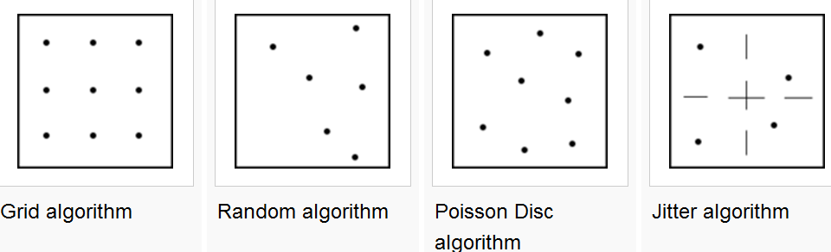
Types of Super Sampling
There are several types of super sampling available, and all are variations on where the extra samples are taken inside the pixel

Slide 36
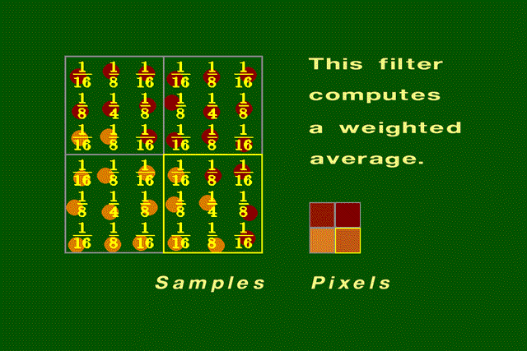
Using a filter to compute a pixel's color
On the left is a group of samples that will be combined to produce pixel colors. Some of the samples are orange, and some are red. The superimposed numbers are the weights from the filter shown.
The highlighted group of samples on the left are combined using the filter to produce the color of the highlighted pixel on the right.

Slide 37
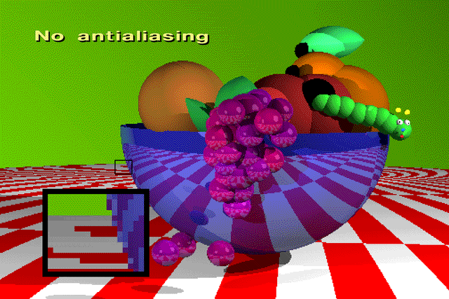
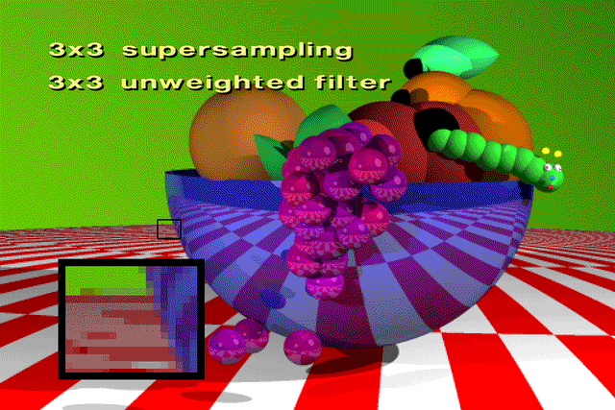

Close Up Example
Resolution 512x342
3x3 super-sampling &3x3 un-weighted filter
1536x1026 regularly-spaced samples using an un-weighted filter. Each of the nine samples taken for a pixel had equal influence on the pixel's computed color.
3x3 super-sampling &3x3 weighted filter
This filter allows samples taken from neighboring pixels to influence the color of the current pixel. The result is softer profiles and edges.

